Slide 1

ABC Pharma – Drug Persistence
Name: Yusuf Aishat
Email: aishatyusuf12@gmail.com
Country: Nigeria
Specialization: Data Science
November 28th, 2024

Slide 2

Agenda
Executive Summary
Problem Statement
Approach
EDA
EDA - Recommendations
Model Performance Comparison
Model Performance Improvement
Model Insights
Conclusion
Recommendations

Slide 3
Executive Summary
Objective
To gather insights on the factors that are impacting persistency, automate the identification of persistent patients and give recommendations to improve persistency rates.
Key findings:
Patients who had DEXA scans during treatment are 372.41% more likely to remain persistent.
Patients treated by pathology specialists are 278.8% more likely to show persistency.
Patients with untreated chronic hypogonadism are 255.6% more likely to stay persistent with their treatment.
Patients treated by oncology specialists are 192.6% more likely to show persistency.
Patients on long-term drug therapy are 132.6% more likely to remain persistent
Recommendations:
Increase screenings and regular check-ups to boost persistence rates
Integrate more patients into IDNs to improve persistence
Educate patients, especially low-risk patients, to encourage treatment adherence and persistence
Enhance collaborations among healthcare providers to share strategies for improving persistence
Personalized interventions for patients at a high risk of being non-persistent with their treatment should be developed.
Challenges faced by patients with mobility issues and frail health should be addressed.
Further investigations into the treatment approaches adopted by specialists associated with low likelihood of persistence should be conducted.
Conduct further research to address the low persistence rates among certain demographics.

Slide 4
Problem Statement
Drug persistence is vital for an effective course of treatment, yet many patients fail to stay persistent with their treatment for various reasons. This lack of persistence can lead to poorer health outcomes, higher health care costs and increased burden on healthcare system.
The company, ABC Pharma, wants to automate the identification of drug persistence as per the physician's prescription. The goal is to build a classification model to predict whether a patient will persist with their treatment and to identify the factors that influence drug persistence.

Slide 5
Approach
The dataset provided tracks patient persistence with their NTM (Non-Tuberculous Mycobacterial Disease) treatment. The dataset contains 3424 records and 69 attributes, each representing patients of various demographics, attributes of their health care provider, clinical factors, disease, and treatment factors.
The dataset was then cleaned by removing columns with high proportions of missing values and handling specific entry errors. Following this, Exploratory Data Analysis was carried out to extract insights about factors affecting persistence.
Then, several classification models were trained on the dataset, and the final model was selected based on its performance and interpretability.

Slide 6
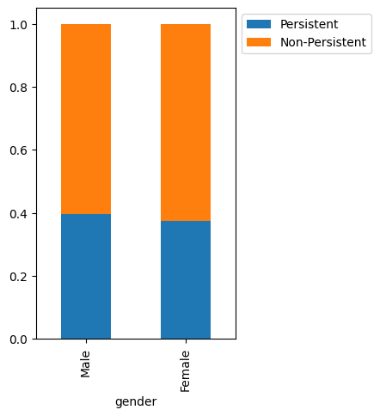
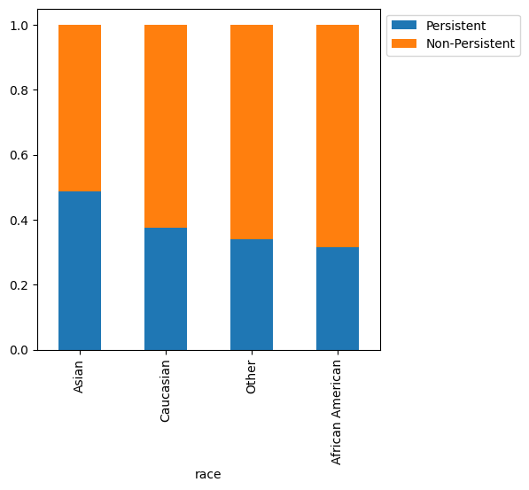
Patient demographics
Male patients have a slightly higher rate of persistence
Asian patients have the highest persistence rate of 48.81% when compared to other groups
African American patients have the lowest persistence rate of 31.58%

Slide 7
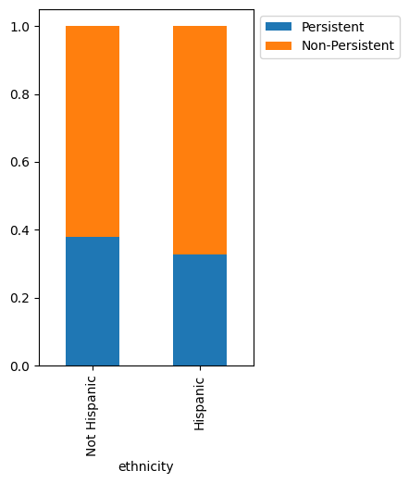
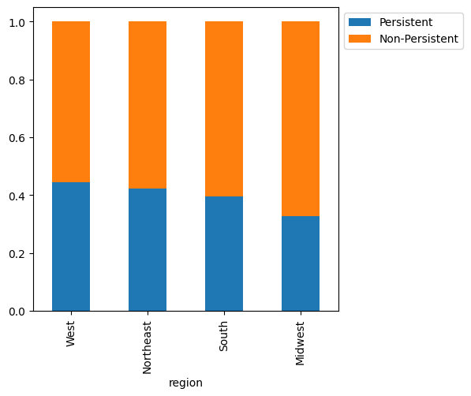
Patient demographics
Non-Hispanic patients have a higher persistence rate of 37.79% compared to Hispanic patients with 32.65%
Patients in the Western region show a higher persistence rate of 44.42%, while those in the Midwest have the lowest persistence rate of 32.85%

Slide 8
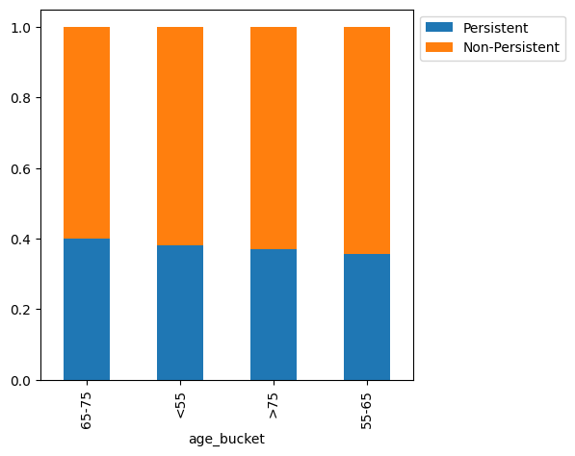
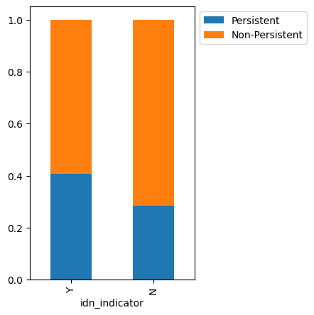
Patient demographics
The difference in the persistent rate among the different age groups isn’t so pronounced and the age group with the highest persistence rate is those aged 65-75 with 39.87%
Patients mapped to an IDN have a much higher persistent rate (40.79%) than those who are not.

Slide 9
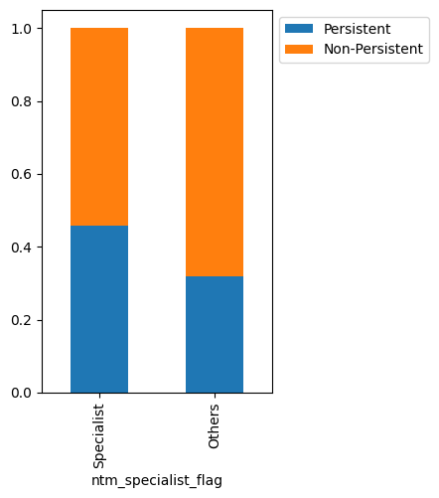
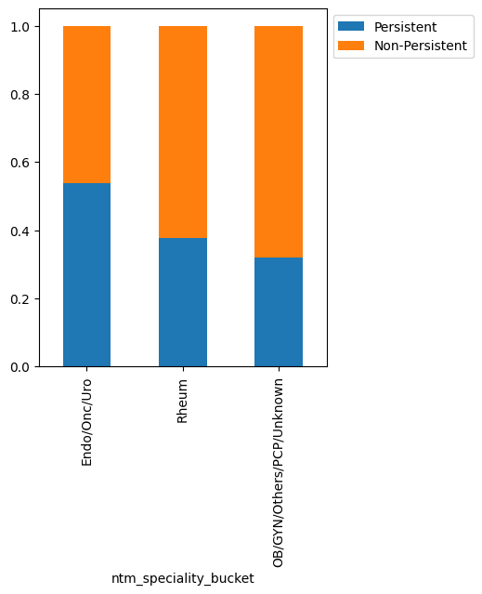
Provider Attributes
* NTM Specialist Flag: Patients seen by a specialist have a higher persistence rate at 45.71%
* NTM Specialist Bucket: Patients treated by Endocrinologists/Oncologists/Urologist have a higher persistence rate at 53.91%

Slide 10
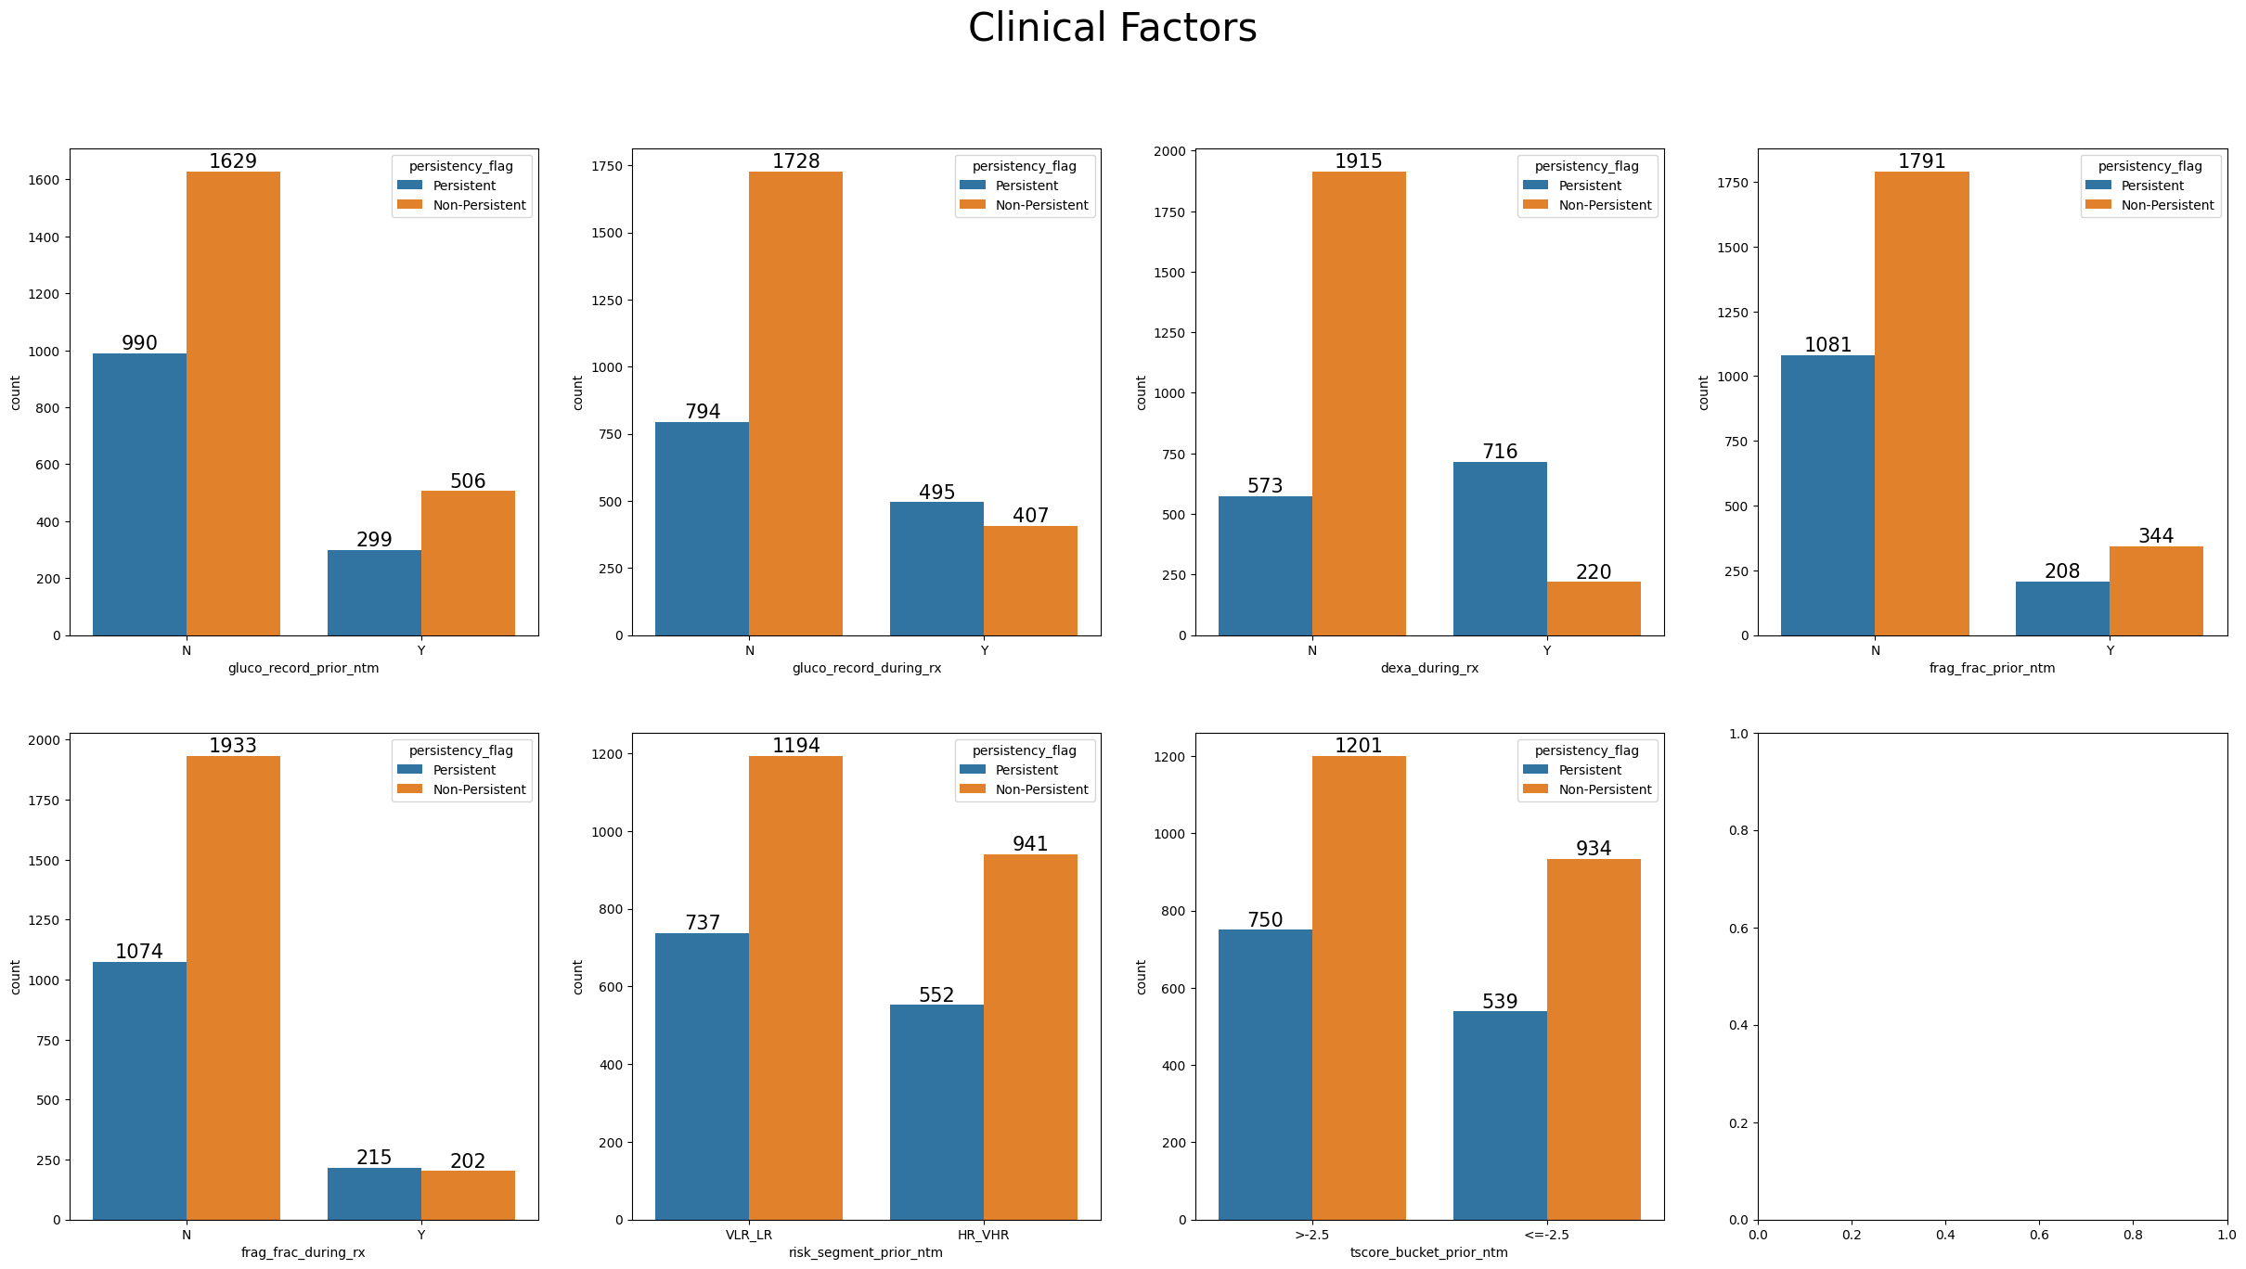
Clinical factors
Patients who had recorded glucocorticoid usage during therapy, DEXA scans during treatment and fragility fracture during therapy had a higher rate of persistence

Slide 11
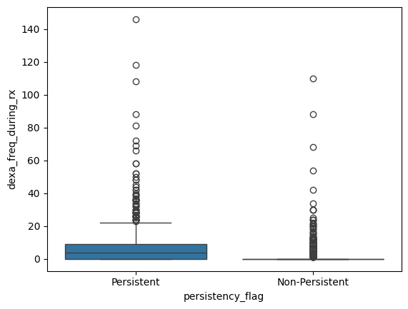
Clinical factors
Patients persistent with their treatment on average have higher frequencies of dexa scans

Slide 12
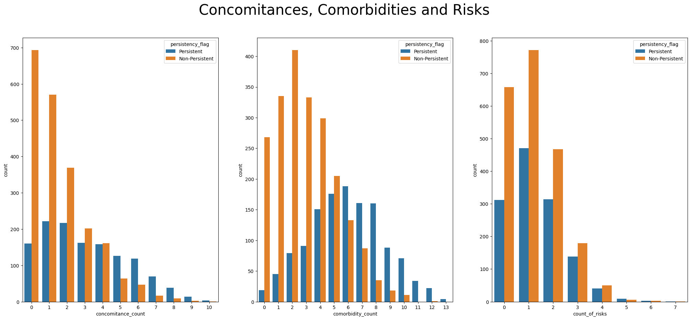
Disease and Treatment Factors
There is higher rate of persistence among patients with ≥5 concomitances, comorbidities and risks.
Patients that are Persistent with their treatment are more likely to have multiple concomitances, comorbidities and risks

Slide 13
Disease and Treatment Factors
Comorbidities: Patients with comorbidities tend to have higher persistence rates except for those with lipoprotein metabolism and other lipidemias or osteoporosis without current pathological fracture.
Concomitances: Patients with concomitances involving cholesterol and triglyceride regulating preparations or antidepressants and mood stabilizers show lower persistence rates
Risks: Patients with risks tend to show lower persistence rates except for those with rheumatoid arthritis or untreated chronic hypogonadism

Slide 14
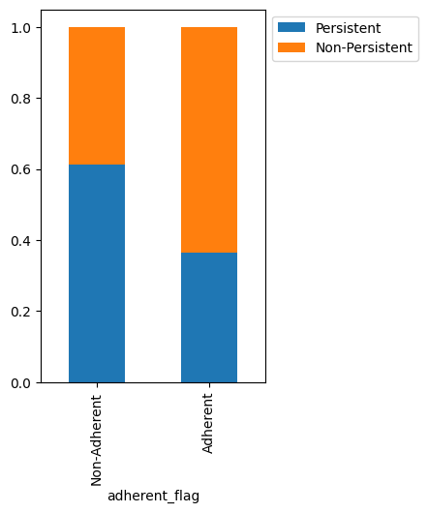
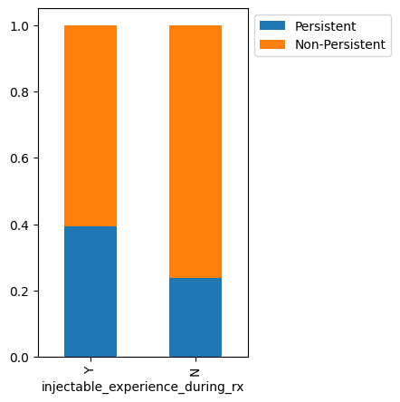
Disease and Treatment Factors
Patients with injectable experience during treatment have a higher rate of persistence at 39.30%
The percentage of Persistent patients is higher among the Non-Adherent patients (61.27%) compared to Adherent patients (36.39%)

Slide 15
Disease and Treatment Factors
Adherence
The persistence of non-adherent patients is much higher (61.27%) compared to adherent patients (36.38%). This is peculiar, as one might expect an adherent patient to be more persistent with their treatment. Upon further analysis, some factors were found to be prevalent among non-adherent and adherent groups who maintain drug persistency. These factors include:
* Presence of DEXA scans during treatment
* Comorbidity screening for malignant neoplasms
* Comorbidity encounter for immunization
* General exam without complaints, suspected or reported diagnosis
* Disorders of lipoprotein metabolism and other lipidemias
* Risk of vitamin D insufficiency

Slide 16
EDA - Recommendations
Increased screenings, preventive exams and improved monitoring of patients through more regular check ups would facilitate an increase in persistence rates
Patients with an IDN indicator have higher rates of persistence; integrating more patients into this network would surely improve persistence
Patients with low risks, comorbidities, and concomitances are more likely to be non-persistent because they may not feel the need to be persistent with their treatment. Patient education would help improve persistency.
Enhancing collaboration among healthcare providers so they can share methods and strategies that help improve persistence.
Further studies can be conducted to figure out why certain demographic groups have lower drug persistence and results from these studies can help create targeted interventions to help increase the persistence in these groups

Slide 17
Model Performance Comparison
The primary goal is to predict if a patient would be persistent in their treatment while identifying the key factors influencing persistency.
To achieve this, multiple classification models were tested including Logistic Regression, Decision Trees, and Random Forests.
The predictive performance and interpretability of these models were taken into account before the final model selection.

Slide 18
Model Performance Comparison
Logistic Regression Performance:
Training AUC score: 0.89
Testing AUC score: 0.87
Metric | Training performance | Testing performance
Accuracy | 0.82 | 0.80
Recall | 0.70 | 0.64
Precision | 0.79 | 0.78
F1 score | 0.74 | 0.70

Slide 19
Model Performance Comparison
Decision Tree Performance:
Training AUC score: 0.82
Testing AUC score: 0.76
Metric | Training performance | Testing performance
Accuracy | 0.83 | 0.77
Recall | 0.81 | 0.73
Precision | 0.75 | 0.68
F1 score | 0.78 | 0.70

Slide 20
Model Performance Comparison
Random Forest Performance:
Training AUC score: 0.98
Testing AUC score: 0.78
Metric | Training performance | Testing performance
Accuracy | 0.98 | 0.81
Recall | 0.97 | 0.67
Precision | 0.99 | 0.80
F1 score | 0.98 | 0.72

Slide 21
Model Performance Comparison
Logistic Regression was selected as the final model because it demonstrated the best performance among the models tested. In addition, due to its high interpretability, it will generate insights into the factors that significantly affect persistency.

Slide 22
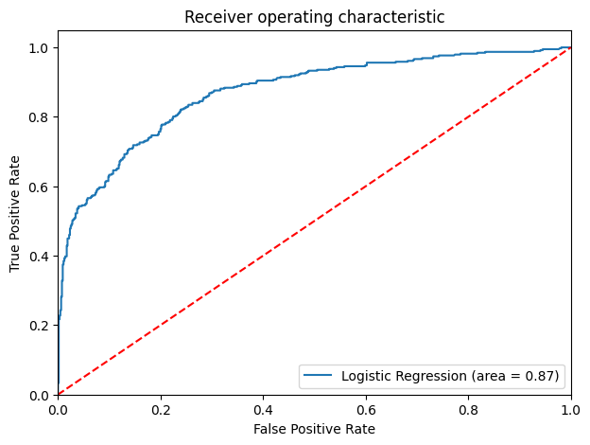
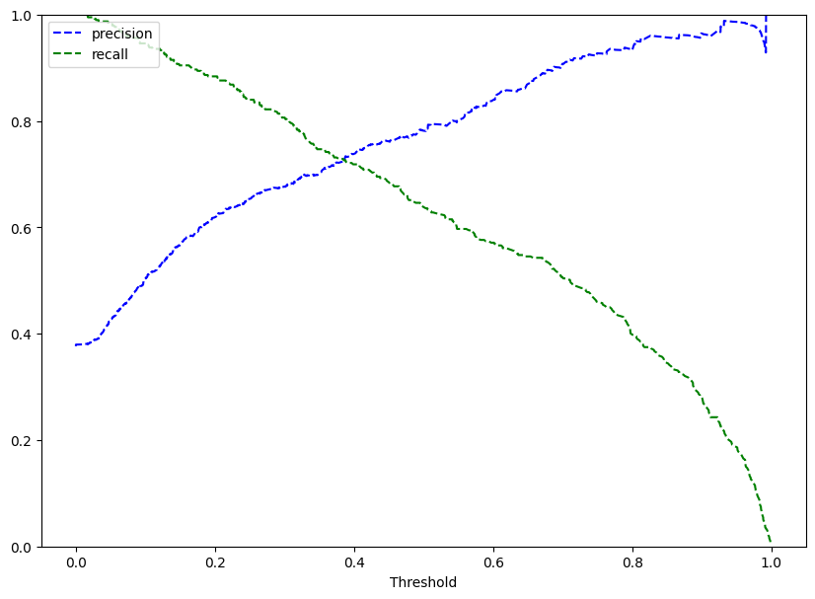
Model Performance Improvement – Logistic Regression
Optimal AUC-ROC curve threshold: 0.28
Optimal Precision-Recall Curve threshold: 0.38

Slide 23
Threshold Comparison
Training performance:
Testing performance:
 | Logistic Regression – default threshold | Logistic Regression – 0.28 threshold | Logistic Regression – 0.38 threshold
Accuracy | 0.82 | 0.79 | 0.81
Recall | 0.70 | 0.84 | 0.76
Precision | 0.79 | 0.67 | 0.74
F1 | 0.74 | 0.74 | 0.75
 | Logistic Regression – default threshold | Logistic Regression – 0.28 threshold | Logistic Regression – 0.38 threshold
Accuracy | 0.79 | 0.78 | 0.79
Recall | 0.63 | 0.82 | 0.73
Precision | 0.78 | 0.67 | 0.73
F1 | 0.70 | 0.74 | 0.73

Slide 24
Key insights from the model
The following are some of the top features that significantly influence persistency positively based on the logistic regression model.
Patients who had DEXA scans during treatment are 372.41% more likely to remain persistent.
Patients treated by pathology specialists are 278.8% more likely to show persistency.
Patients with untreated chronic hypogonadism are 255.6% more likely to stay persistent with their treatment.
Patients treated by oncology specialists are 192.6% more likely to show persistency.
Patients on long-term drug therapy are 132.6% more likely to remain persistent

Slide 25
Key insights from the model
The following features show a negative impact on persistency:
Patients who are immobilized.
Patients treated by physical medicine and rehabilitation specialists.
Patients with poor frail health
Patients on narcotics
Patients treated by General Practitioners

Slide 26
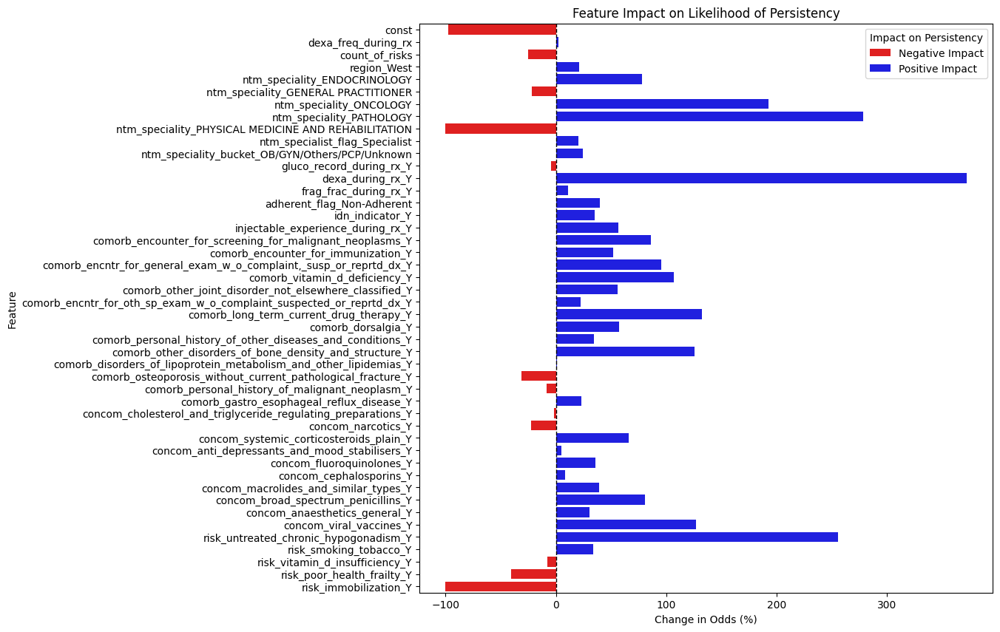

Slide 27
Conclusion
The logistic regression model was chosen as the final model for prediction based on its interpretability and strong performance with an AUC score of 0.89
Patients treated by Oncologists and Pathologists show high likelihood of persistency.
Those undergoing long-term drug therapy and receiving DEXA scans also demonstrate a high likelihood of persistency
However, patients facing mobility challenges or in poor frail health, show very low likelihood of persistency.

Slide 28
Recommendations
Personalized interventions for patients at a high risk of being non-persistent with their treatment should be developed.
Challenges faced by patients with mobility issues and frail health should be addressed.
Further investigations into the treatment approaches adopted by specialists associated with low likelihood of persistence should be conducted.
The model should be used in patient risk assessment and periodically retrained with updated data for continued reliability.

Slide 29
Thank You

